Slide 1
Functions in Shell scripting (Unix)

Slide 2
Function
a function is a block of code that performs a specific task
in shell scripting
A function is a group of commands that are assigned a name that acts like a handle to that group of commands
To execute this group of commands defined in the function, you simply call the function by the name you provided.

Slide 3
Advantages of Functions
It helps us to reuse the code.
• Improve the readability of the program.
• Efficient use of variables inside the program.
• Allows us to test the program part by part.

Slide 4
How many ways we can create and execute Functions
There are many way but here, i am giving four ways:
1-way
2-way
3-way
4-way

Slide 5
Syntax of Functions in Shell scripting
Syntax1:
function function_name {
###set of commands
}
Syntax2:
function_name() {
####set of commands
}

Slide 6
Explanation
function is a key work that declares the function definition.
function_name is the name of the declared function.
Curly braces {} acts as delimiters that enclose the function’s code.
Set of commands are the code to be executed when the function is called.
So, a function is declared first, and then called when needed.

Slide 7
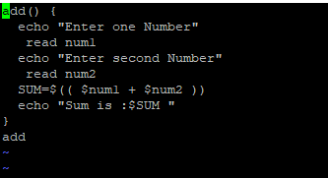

1-way output

Slide 8
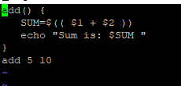

2-way output

Slide 9
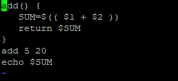

3-way output

Slide 10
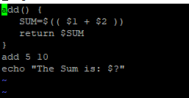

4th-way output

Slide 11
Thank you

